Slide 1
The Human Brain: Teen Version
Notes:
Hi I’m Dr. Peg Dawson. I’m a psychologist and the co-author of a number of books on executive skills. This is a PowerPoint I put together to help teenagers understand what executive skills are and the role they play in school success. Before I talk about these skills specifically, though, I want to give you some information about the teen brain and what makes the brains of teenagers different from those of adults. Adolescence is a unique time in human development and a lot of the changes that teens are experiencing are happening in the brain.

Slide 2
What every teenager needs to know about executive skills (and a few other things about the brain)

Slide 3
At birth…
The human brain weighs 13 ounces. By the late teen years it will weigh just under 3 pounds.
In the first six years of life your brain creates neural connections at the rate of about a million new synapses per second.
That’s great for learning new skills (like walking and talking), but too many neural circuits can get in the way, too. This leads to…

Slide 4
A process called “pruning.”

Slide 5
WHAT’S PRUNING?!
Because the number of neural circuits has become unmanageable by the early teen years, the brain starts a “weeding” process—eliminating the neural connections it’s not using.

Slide 6
So how are you spending your time?
And what are you NOT doing? Those are the skills you risk losing.

Slide 7
What are your pruning targets?
Video games
Texting
Social media
Zoning out in front of the television
Smart phone games
Surfing the Net
Watching YouTube videos
Reading
Thinking about what you’ve read
Learning a foreign language
Learning how to code or create a webpage
Playing a musical instrument

Slide 8
Believe it or not, thanks to pruning, the teen years are a GREAT time to learn new skills

Slide 9
Why? Because when you weed out neural connections you’re not using, the ones that remain work WAY better!

Slide 10
Way better how?
They transmit larger quantities of information;
They transmit that information faster; and
They connect with more distant regions of the brain more efficiently.
Your brain will never be more “plastic” (i.e., capable of change) than it is right now.

Slide 11
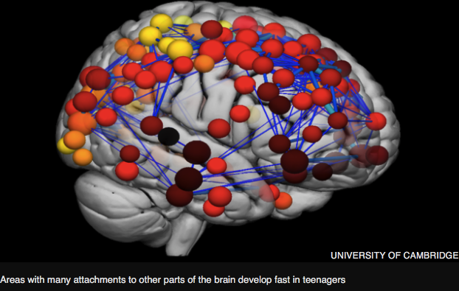

Slide 12
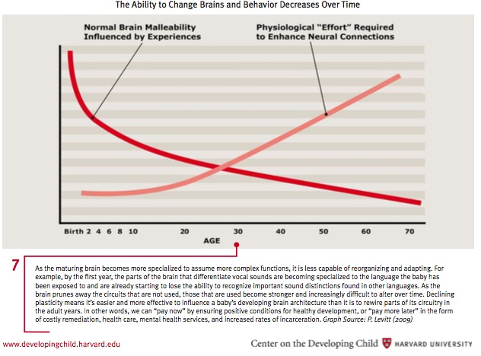
Notes:
This graphic shows how easily the brain changes in the earliest years of life. This is represented by the dark red line. The lighter line shows how much effort it takes to change the brain. Make the point that in the first few years of life we rack up lots of experiences and the brain changes quickly and easily—think about learning how to walk and talk and navigate the physical world during the preschool years. Although the brain becomes a little less malleable as childhood progresses, the amount of effort stays pretty much the same until the late teens. This is why this is a good time to establish the skills we’ll need to be independent as adults.

Slide 13
So your brain is primed to learn new things—but how does that learning process take place?

Slide 14
Time to talk about myelin.

Slide 15
Myelin is a fatty layer that wraps itself around nerve cells.
It acts as insulation, increasing the speed with which nerve impulses are transmitted. The thicker the myelin, the faster the impulse travels. The faster the impulse, the better the skill.
Notes:
This is an electron microscope picture of nerve cells—the dark center is the cell and the lighter part around it is the myelin. To help people understand how myelin works, make the analogy to insulation on an electric cord—a similar process is involved.

Slide 16
ALL skills improve with practice…
The more you practice, the better the skill. Practice also makes the task less effortful.
Notes:
This might be a good place to have a discussion about the impact of practice on athletic skill. Why do basketball players spend hours practicing free throws or 3-point shots? Have students supply personal examples of how practice helped them get better at something. Playing an instrument is another example—as are video games. You may also want to explain that in the very early stages of learning a skill the brain burns a tremendous amount of glucose—the fuel that powers the brain, whereas the better you get at a skill, the less glucose it takes to produce a higher level response. Here’s what they found teaching novice Tetris players to learn the game: In first-time users, Tetris significantly raises cerebral glucose metabolic rates (GMRs), meaning brain energy consumption soars. Yet, after four to eight weeks of daily doses, GMRs sink to normal, while performance increases seven-fold, on average. Tetris trains your brain to stop using inefficient gray matter, perhaps a key cognitive strategy for learning. In fact, the lowest final GMRs are found in the best players' brains, the ones most efficient at dealing with Tetris's Daedalian geometry.

Slide 17
This brings us to executive skills

Slide 18
Executive skills are located in the frontal lobes (the part of the brain right behind the forehead).

Slide 19
They are a cluster of disparate skills, but what they have in common is that they are the skills we use to execute tasks.

Slide 20
They include (we’ll explain them in a bit)….
Response inhibition
Working memory
Emotional control
Flexibility
Sustained attention
Task initiation
Planning
Organization
Time management
Goal-directed persistence
Metacognition

Slide 21
Here’s what we know about frontal lobes
They’re the last part of the brain to fully develop.
In fact, they take 25 years at least to reach full maturation.

Slide 22
Watch the brain change.
Notes:
http://www.nytimes.com/interactive/2008/09/15/health/20080915-brain-development.html
This is the link to the NY Times interactive that shows a series of MRI scans between the ages of 4 and 21. I usually scan quickly from beginning to end and then bring it back to age 13. If you’re using it with high school students, you could select a different age.

Slide 23
Something else we know about frontal lobes
Different parts of the frontal lobes mature at different rates.

Slide 24
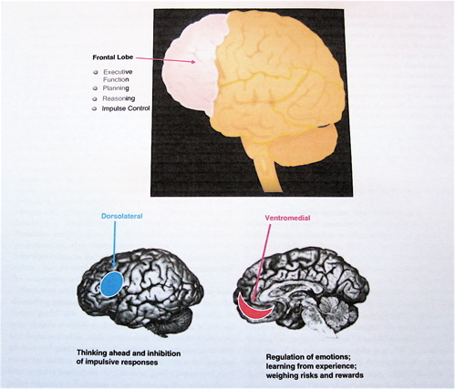
For instance, the part that handles rational decision-making matures faster than the part that manages risk-taking.
Notes:
The red image on the right represents the part of the brain associated with decision making: the ventromedial prefrontal cortex, if you want to use the technical term. The blue portion on the left shows where impulse control resides—the dorsolateral prefrontal cortex. You might be able to elicit examples from students about when impulsivity overrode good decision-making. I often use the example of texting and driving. Asked whether it’s a good idea, no teenager says yes. But when you’re behind the wheel and the cell phone is sitting on the passenger seat, it’s almost irresistible when you hear that ping—you pick up the phone without even thinking.

Slide 25
What does that mean?
The teenage brain is like a Ferrari: it’s sleek, shiny, sexy, and fast, and it corners really well. But it also has really crappy brakes.
Notes:
This is a quote from a Parade Magazine article on the teen brain that was published several years ago

Slide 26
But not only are teen brains impulsive compared to adults
They’re also way more emotional!#!

Slide 27
This is because especially during the early teen years, the frontal lobes, (which govern self-control) are only loosely connected to the limbic system (which supports emotions).
Notes:
The colored portion here represents the limbic system. In particular, you may want to mention the amgydala, which is the “fight or flight” portion and the hippocampus, which stores past memories.

Slide 28
What does this mean?
The emotional brain takes over in emotionally charged situations: teens tend to be quick to anger, have intense mood swings, and are likely to make decisions based on “gut feelings.”
Teens rely on “hot cognition” rather than “cold cognition”—being swayed by hot emotions more than cool reason.

Slide 29
As executive skills mature (and remember, it takes 25 years at least for this to happen)…
The frontal lobes slowly get more control over the limbic system. As this happens, your executive skills improve and the choices you make are less likely to get you in trouble.

Slide 30
So let’s look more closely at those skills…

Slide 31
Response inhibition
Being able to control your impulses so you can think before you act, resist peer pressure, and make good choices (e.g., choosing to study rather than being on social media).

Slide 32
Working Memory
Being able to keep in mind everything you have to remember—and remembering what worked the last time.

Slide 33
Emotional Control
Being able to manage your feelings so they don’t get in the way of getting work done or meeting goals.

Slide 34
Flexibility
The ability to adapt to unexpected events and to come up with more than one solution to a problem.

Slide 35
Sustained Attention
Staying on task, getting things done in the time you’ve given yourself to do them even if you’re tired, bored, or have more appealing distractions.

Slide 36
Task Initiation
Being able to make yourself start a task. This is a tough skill to learn, so if you’ve seen yourself getting closer to your goal this is the first step on that path.

Slide 37
Planning/Prioritizing
Planning is your road map, your GPS. When you have a good plan, you know all the turns you have to make and how to get past the roadblocks along the way. You also can focus on what’s important and let the little things go.

Slide 38
Organization
Having a system for keeping track of information and materials, especially the things you need every day (phone, keys, homework, sports gear)—putting everything in its place so when you look for it, it’s there.

Slide 39
Time Management
Time management allows you to manage the tug of war between what you want to do, what you need to do, and what others ask you to do. A key piece of time management is the ability to estimate how long it takes you to do something.

Slide 40
Goal-Directed Persistence
This is a giant version of sustained attention (with some response inhibition thrown in there, too). This involves making a goal, being determined to get there, and keeping the goal in mind as you make decisions about how you spend your time.

Slide 41
Metacognition
This is your brain’s life lesson machine. It allows you to reflect on past actions and behaviors and make informed decisions about how you will act in the future. The formula:
what did I do +
why did I do it =
what will I do the next time?

Slide 42
Here’s something else we understand about executive skills:
People (both kids and adults) seem to have both executive skill strengths and executive skill challenges—some skills come more easily and naturally than others, and individuals vary in their executive skills profile.

Slide 43
Would you like to learn what your profile is?
Take our questionnaire and find out…
Notes:
It’s included in just about all our books, including Smart but Scattered Teens

Slide 44
Now it’s time to talk
We understand that everyone has a different level of comfort in talking about executive skills. We offer three options:
Decide you are ready to dive right in and practice using the scripts on the next slide.
Decide to watch the sample conversation and read the scripts now but not participate.
Decide that this is not for you right now and leave the webinar after watching the sample conversation. You can access the slide show from your email when you are ready.

Slide 45
Model Conversation
Notes:
https://youtu.be/YCaEJFNJCeY

Slide 46
Script for discussion topic 1 Parents’ executive skill strengths
Here are my strongest skills: (list 2 or 3). Here’s how I use them (describe how the skill helps you at home, on the job, or in relationships).
Do you agree that these are strengths for me, or do you see things differently?
Allow your child to share their opinion without judging whether they’re right or wrong. If they don’t agree, you might say, “That’s interesting—I hadn’t really thought about it that way.”

Slide 47
Script for discussion topic 2 Kids’ executive skill strengths
Parent asks: What are your strongest skills? Child should select 2-3.
How do these skills help you at school or at home or with friends or with your family?
If you can, give your child other examples of how you see them use their executive skill strengths.
Accept your child’s self-assessment without judgment. However, if you think your child has missed a skill that you think is a strength, mention it and give an example of how the child has used that skill successfully.

Slide 48
Script for discussion topic 3 Parents’ executive skill challenges
One of my executive skill challenges is ___________. Here’s how this can get in the way for me (use examples from home, work, or relationships).
Repeat this with 1-2 other skills.
You may want to give your child the opportunity to share other examples of how they’ve seen your executive skill challenge “in action.” Be able to laugh at yourself (!)

Slide 49
Script for discussion topic 4 Kids’ executive skill challenges
So, what have you listed as your biggest challenges?
Can you give an example of how those challenges get in the way (at home, at school, in a job, or in relationships?)

Slide 50
Comparing Profiles
We have found that people who are naturally good at a particular executive skill have difficulty understanding people who are naturally “bad” at that same skill.
In fact, where profiles differ can sometimes signal tension points in relationships.
Between now and our next session, you may want to think about whether the differences in your profiles contribute to a lack of understanding—not to mention the occasional argument!

Slide 51
Debrief and Next Steps
In the Q&A consider writing in how you might finish this sentence:
Tonight, I learned…
Next time we meet…

Slide 52
MHS Guidance Counselor Assignments
A ~ C Brianna.Ledoux@Sau26.org Ms. Ledoux
D ~ G Rebekah.Spotts@Sau26.org Ms. Spotts
H ~ Maq Tania.Isenberger@Sau26.org Ms. Isenberger
Mar ~ Rob Katherine.Colbert@Sau26.org Mrs. Colbert
Roc ~ Z Daniel.Leone@Sau26.org Mr. Leone
Guidance phone number (603) 424-6204 ext. 2

