Slide 1
Updates from SoCaLS* and Human Resources *System of Care and Learning Supports
Presented by:
Fern Seiden, System of Care Coordinator
and
Melissa Gagne, Human Resources Manager

Slide 2
Trauma Informed SEL – Educators and Schools Doing the Work
IPDPS, SLPS, CAGS Capstone Projects with SEL focus
SST meetings with Trauma Informed Intervention focus
Using SEL classroom practices to manage hardships and challenges of the pandemic
Supporting staff, students and families/caregivers in creative ways across each school
Book groups
Communication with families
Planning for March 15th and Preparing Students for Changes to Schedules

Slide 3
SoCaLS Update: Promising Futures Grant
Promising Futures Grant – $115,000.00
Multi-Tiered System of Support (MTSS-B) Exploration Team – training and development
ThinkKids – Restorative Practices readiness assessment
Universal, Prevention Programs:
MHS – Executive Functioning and Extended Home Room
MHS – Advisory Program
JMUES – Self-Regulation and SEL with Mindfulness Focus
District PD and Community Trainings: Lynn Lyons, Search Institute, Brooklyn Raney and More

Slide 4
SoCaLS Update: Suicide Prevention Training
All staff trained across the district with "More than Sad" Program from the American Foundation of Suicide Prevention
Family/Caregiver Training, 2/18/21 at 6:00 PM
Information and link is on District website calendar

Slide 5
SoCaLS Update: Developing Partnerships and Accessing Resources
REAL
Partnership for Universal Learning
NAMI
American Foundation for Suicide Prevention
Change Directions
Waypoint Family Resource Center
FAST FORWARD
Harbor Care
Greater Nashua Mental Health
DCYF Advisory Team
Bridges
Cassie Yackley and Associates for Trauma Informed Practices
Greater Nashua Smart Start Coalition
Bureau of Student Wellness
Playworks
GoalBook for Counselors and Behavior Specialists
Presence Learning
SEARCH Institute
REL-SEL
SEL in Action

Slide 6
Building an SEL/mental health focus within and across schools and teams
Communication and Teaming
School Counselor, Behavior Specialists and Home School Liaisons Teams – meetings to discuss and share best practices and offer consult
Workshops for families/caregivers offered after school: Fern Seiden, Sarah Kennedy, Sio Fuller, Bob Walrath – More to come
Joining Middle and High School Student Support Team meetings
Supporting Reflective Practice Groups
Supporting REAL educator meetings
Newsletters and Website (Developing CANVAS site)
SoCaLS Committee Focus:
Transitions
DATA
Educator and Family supports
Expansion of SEL Competencies

Slide 7
Family and Employee Support Teams
Work Groups of SoCaLS

Slide 8
Members of the Support Teams
Family/Caregiver Support Team Members
Kristine Colburn, Special Education Teacher, MES
Sio Fuller, Intern, Student Services
Laura Livie, School Counselor, RFS
Christina Marino , Mental Health Counselor Intern
Bill Morris, REAL Coordinator
Scott Riddell, Special Education Coordinator, MHS
Fern Seiden, System of Care Coordinator
Ashleigh Lowe, Parent Representative
Katelyn Bernier, Parent Representative
Dr. Bob Walrath, School Psychologist
District Employee Support Group Members
Doug Bonnema, School Counselor, TFS
Tracy Cassell, Speech Teacher, MES
Julie DeLuca, Principal, TFS
Cassie Duncan, School Counselor, MES
Sio Fuller, Intern, Student Services
Melissa Gagne, Human Resources Manager
Kelly Grassini, School Nurse, RFS
Bill Morris, REAL Coordinator
Fern Seiden, System of Care Coordinator
Paula Williams, Human Resources Coordinator
Bryan Young, Guidance Counselor, MUES

Slide 9
Family/Caregiver Support Team Overview
Providing resources – i.e. Winter resource guide for families
Merry-mac Holiday Help
Providing workshops
Getting feedback about community needs, such as finding ways to communicate more consistently where possible
Planning a community event based around theme of “It Takes a Village”
Sharing ideas and practices across schools

Slide 10
The SoCaLS team and HR have partnered to create the District Employee Support Team
Why was this group created?
SoCaLS focus: System of Care supports for student well being
In order to take care of others, we must take care of ourselves
There is a connection between staff and student social emotional well being
Staff SEL is a significant component of System of Care work – a part of the Collaborative for Academic and Social Emotional Learning (CASEL) framework
What is the charge of the District Employee Support Group?
Focus our resources, expertise, and shared commitment on employee well-being
Find ways of supporting our community of employees that do not “add to the plate,” but rather help manage what is on it
Bring awareness to workplace practices and community resources that may help district employees in their personal and professional lives

Slide 11
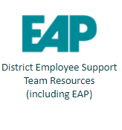
What have we done?
Newsletter announcement from SoCaLS
The February newsletter announced the partnership between SoCaLS and HR to create the District Employee Support Group
Making resources readily available
We have created a page on our Intranet home page
Met collectively since December as a group to brainstorm ways to bring resources to employees

Slide 12
What are our goals?
Partner
Partner with other district committees and efforts to increase participation and awareness to school-based or district wide initiatives
Share
Share district-wide resources that may support employee mental health, with the aim of targeting a range of needs and interests
Respond
Stay abreast of emergent mental health needs and resources, ensuring that we are responsive as a district System of Care, rather than responding within silos
Provide
Provide information and actionable ideas for SoCaLS and Leadership to take under advisement.
Support
Support our community in ways that do not “add to the plate,” but rather help manage what is on it
Awareness
Bring awareness to the Employee Assistance Program, which offers free and confidential tools to employees (including discounts!)

Slide 13
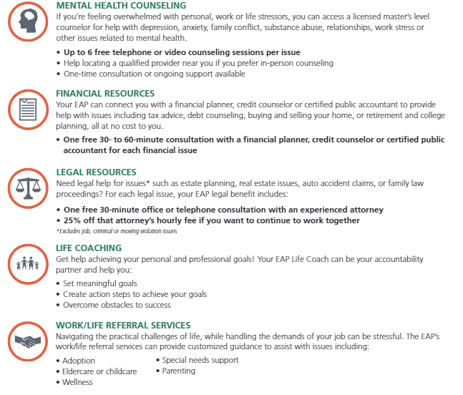
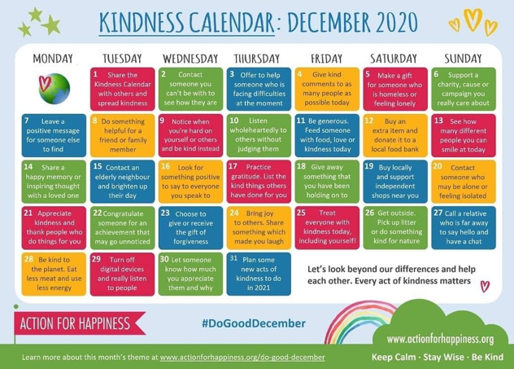
Examples of Resources/ Initiatives

Slide 14
Members of the Support Teams
Questions?
Family/Caregiver Support Team Members
Kristine Colburn, Special Education Teacher, MES
Sio Fuller, Intern, Student Services
Laura Livie, School Counselor, RFS
Christina Marino , Mental Health Counselor Intern
Bill Morris, REAL Coordinator
Scott Riddell, Special Education Coordinator, MHS
Fern Seiden, System of Care Coordinator
Ashleigh Lowe, Parent Representative
Katelyn Bernier, Parent Representative
Dr. Bob Walrath, School Psychologist
District Employee Support Group Members
Doug Bonnema, School Counselor, TFS
Tracy Cassell, Speech Teacher, MES
Julie DeLuca, Principal, TFS
Cassie Duncan, School Counselor, MES
Sio Fuller, Intern, Student Services
Melissa Gagne, Human Resources Manager
Kelly Grassini, School Nurse, RFS
Bill Morris, REAL Coordinator
Fern Seiden, System of Care Coordinator
Paula Williams, Human Resources Coordinator
Bryan Young, Guidance Counselor, MUES

